Slide 1

Malignant comment classifier
Name: NITIN SINGH TATRARI
BATCH No. : 1825

Slide 2
Problem Statement
Online hate, described as abusive language, aggression, cyber bullying, hatefulness and many others has been identified as a major threat on online social media platforms. Research has demonstrated a number of serious consequences of cyber bullying victimization. Victims may have lower self-esteem, increased suicidal ideation, and a variety of emotional responses, including being scared, frustrated, angry, and depressed. Expressing at online platform many times result in hate and conflict, which will lead to many other problems. Thus filtering and removing these hate comments are very important for maintaining the user population.

Slide 3
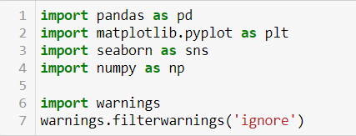

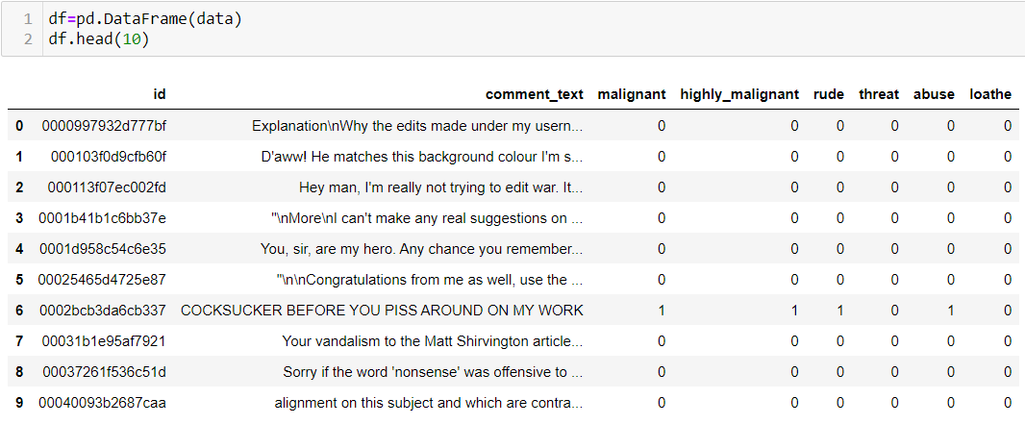
Steps followed: (1) Loading the data
Loading libraries
Uploading data from csv file
Loading data into Data frame ‘df’

Slide 4
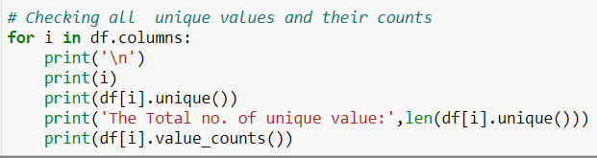

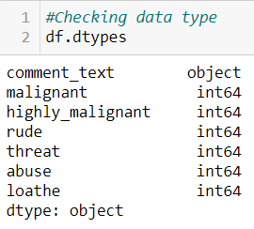
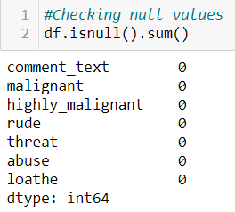
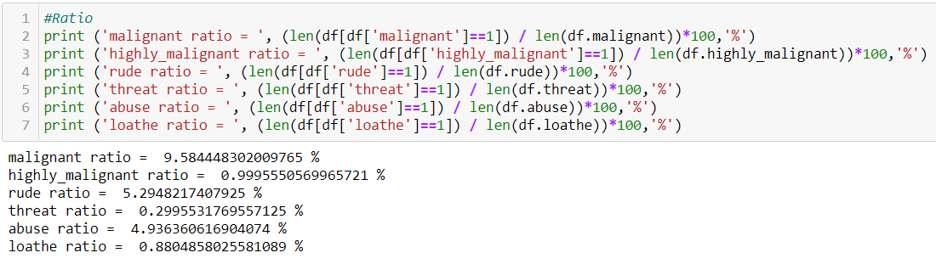
(2) Understanding the data
Column ‘id’ have all unique values, Thus we drop it.
Comment_text is string type, remaining all other are integer types
There is no null values
Data is imbalance

Slide 5
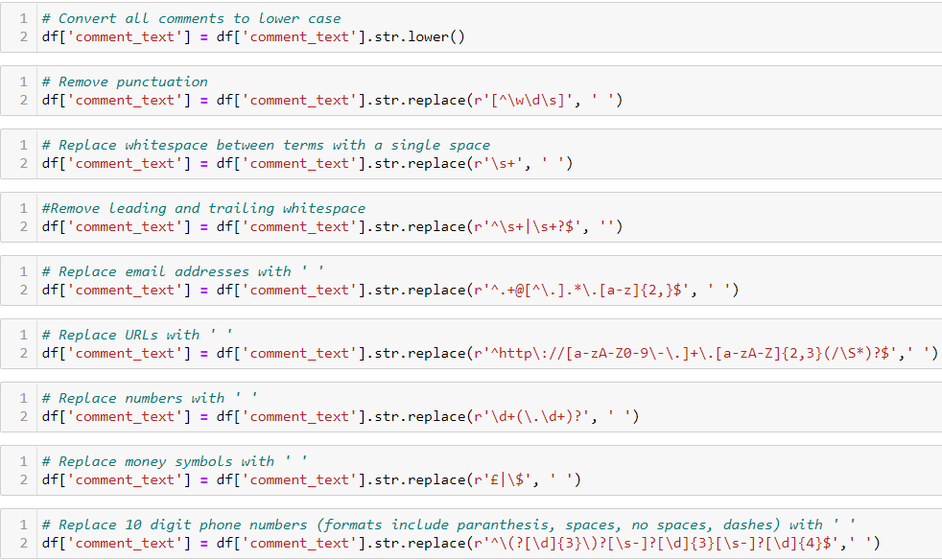
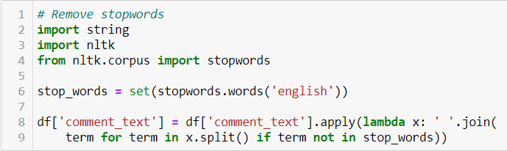
(3) Cleaning the data
We convert all the text into lower.
We have remove all whitespaces, punctuations, email address, URLs, numbers, money symbols and phone number.
We remove the stopwords

Slide 6
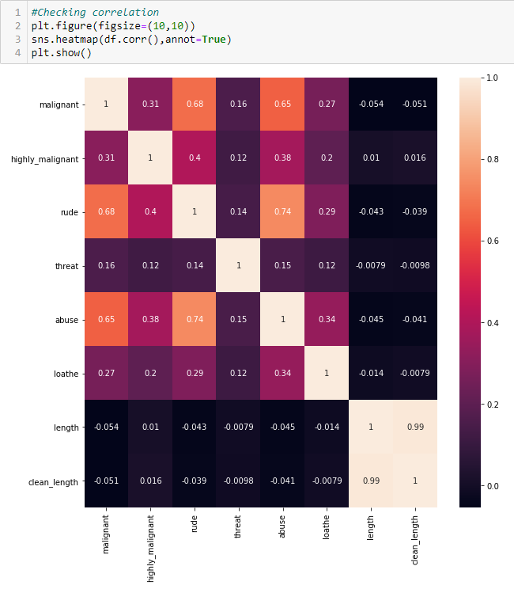
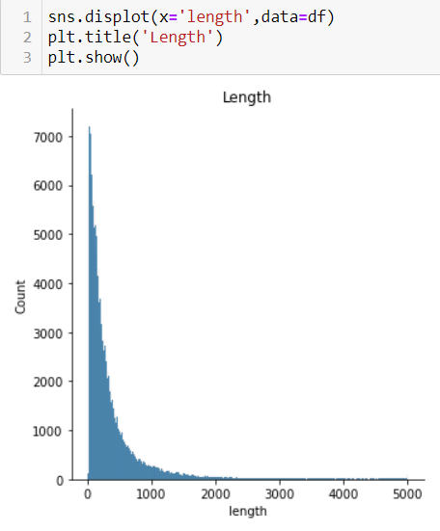
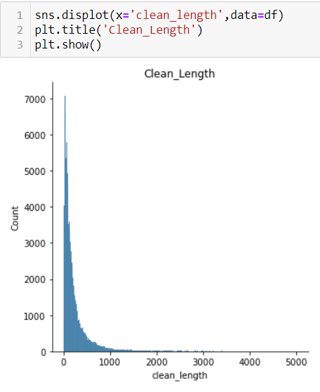
(4) Graphical analysis
There is no relation of length of comments with type of comments
Malignant comment is highly correlated with rude comments and abuse comments
Threat comments and loathe comments have low correlation with other type of comments.
Length decreases after cleaning the data.

Slide 7
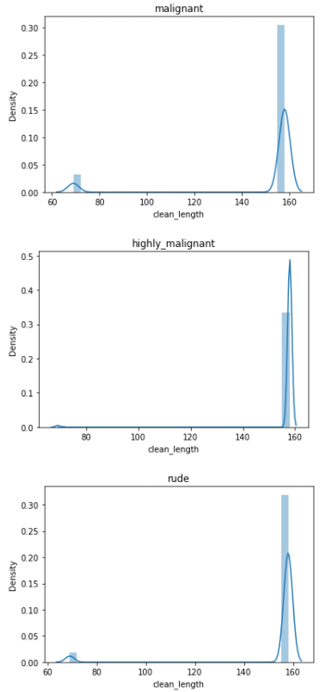
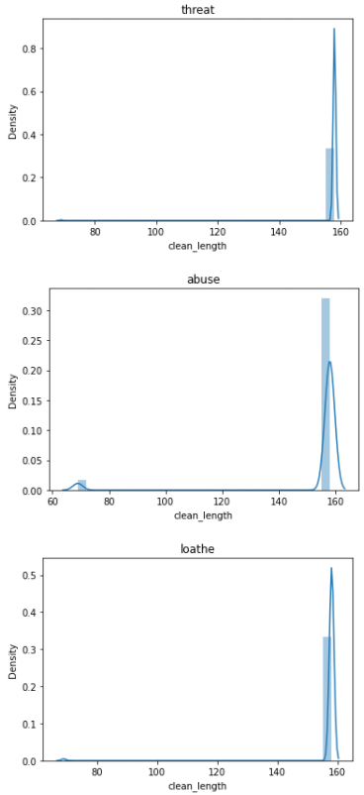

Slide 8
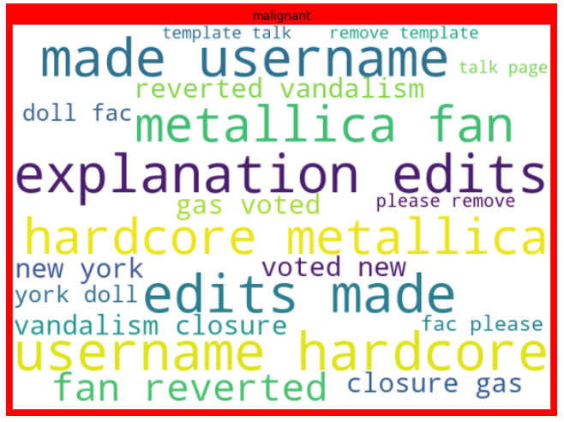
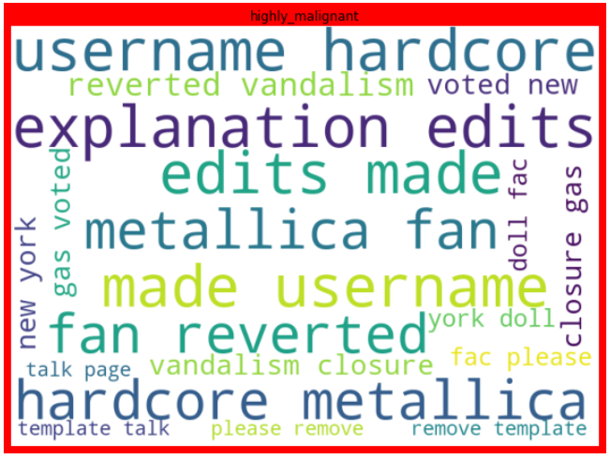
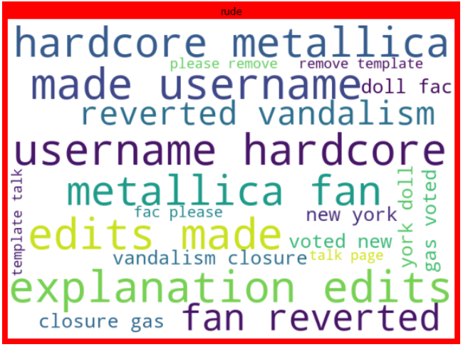
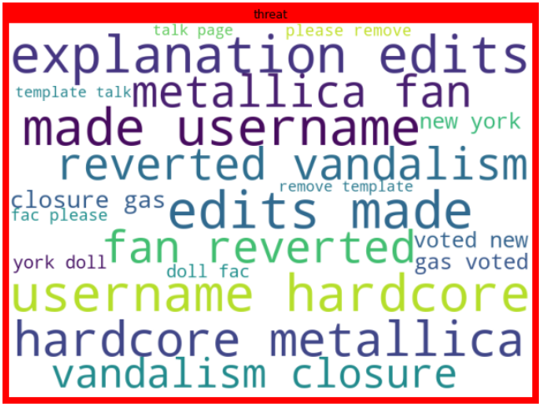
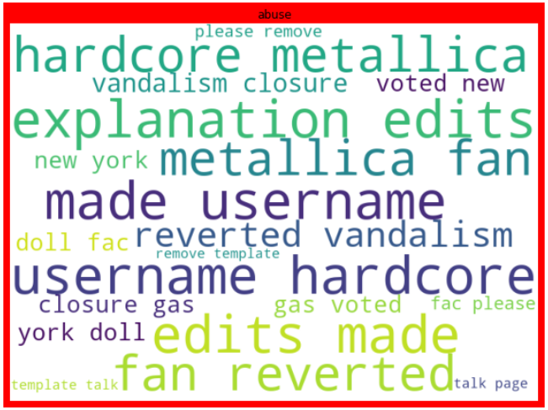
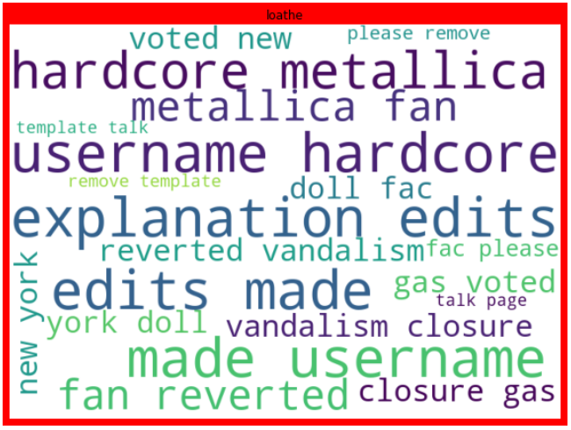

Slide 9
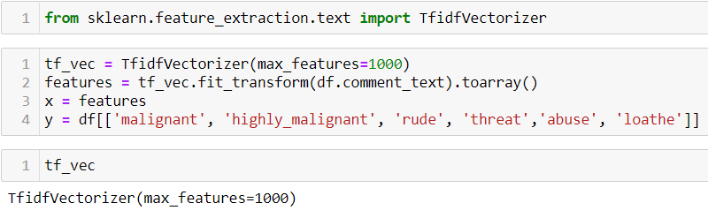
(5) Preprocessing
We convert the texts in comment_text into vector form by apply TF-IDF vectorizer.

Slide 10
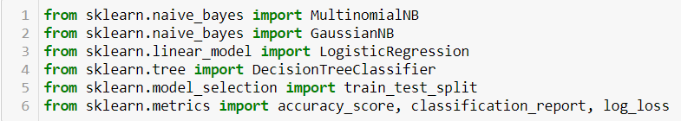
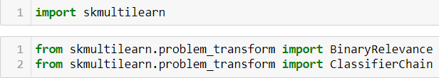
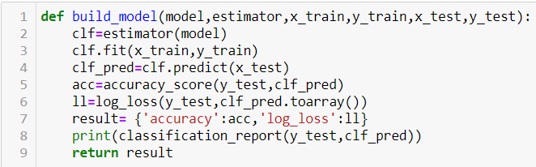
(6) Model Selection
We imports all the algorithm to be applied
We import scikit_ multilearn libraries to convert multi label variables into multi-class variable
We define a function to build a model. Firstly, we convert the multi-label variable to multi-class variable , then apply different algorithms and metrics.

Slide 11
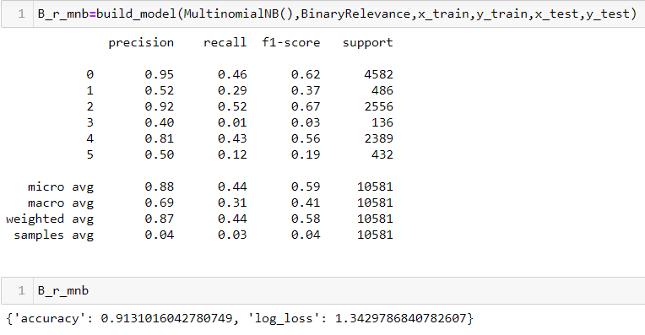
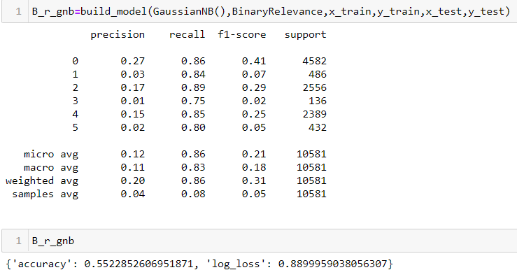
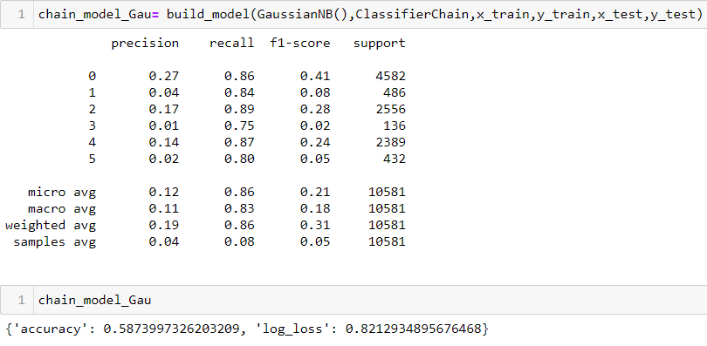
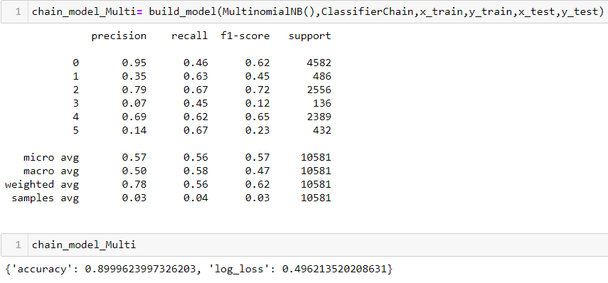
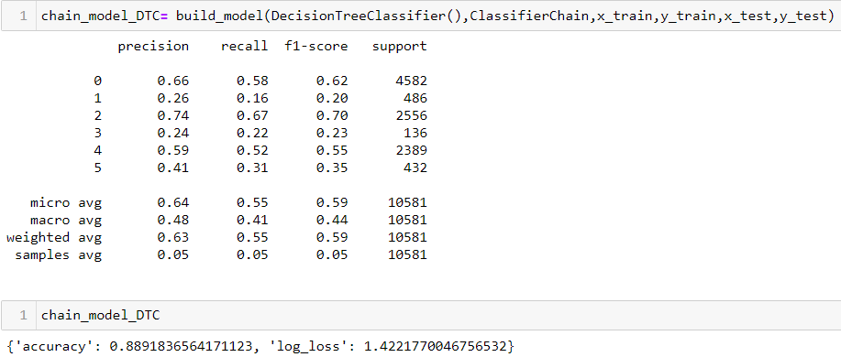
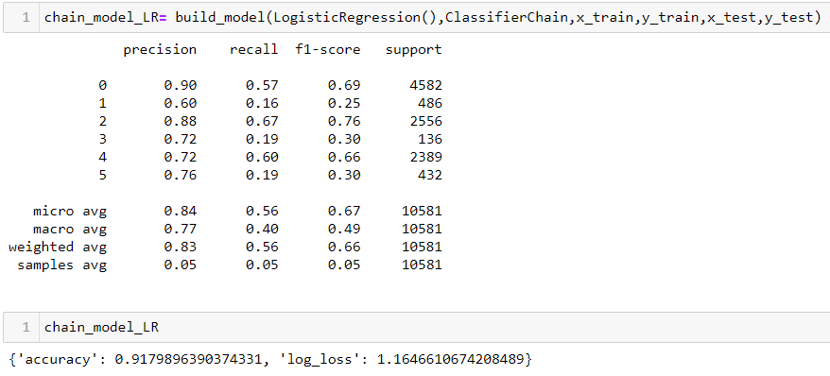

Slide 12
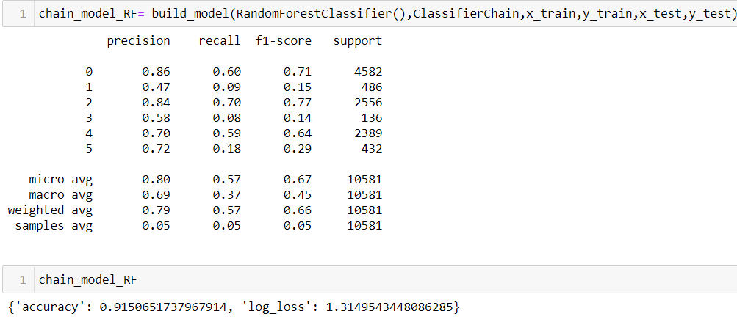
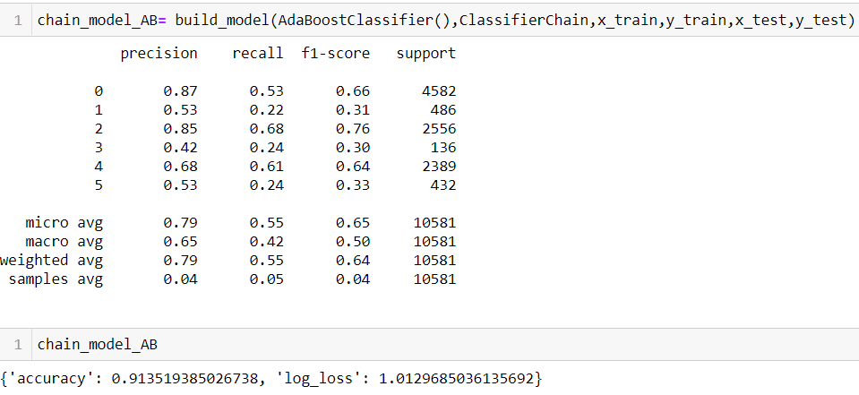
(7) Ensemble Technique
Except Gaussain NB(), all the algorithm gave a accuracy score of between 88-92%.
MultinomialNB() with classifer chain gave the least log_loss of 0.49.
Thus we move forward with it.

Slide 13
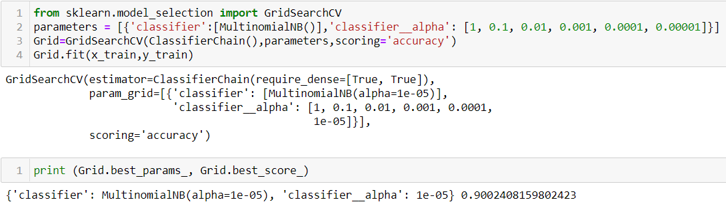
(8) HyperParameter tunning
Thus, we get the best accuracy at aplha value of 0.00001 for MultinomialNB() with classifier chain.

Slide 14
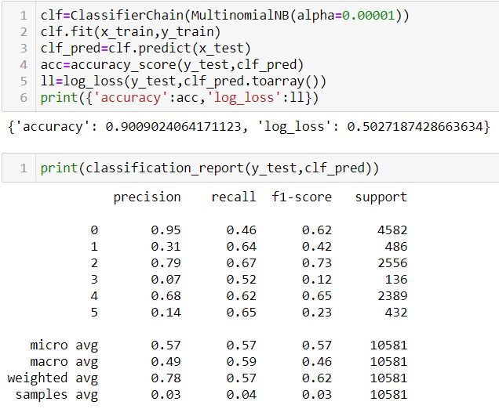
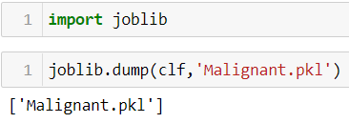
(9) Saving the best model
We save MultinomialNB() with classifier chain as the best model. The alpha value is 0.00001

Slide 15
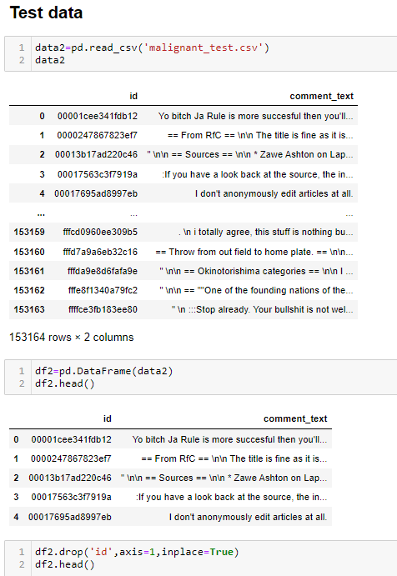
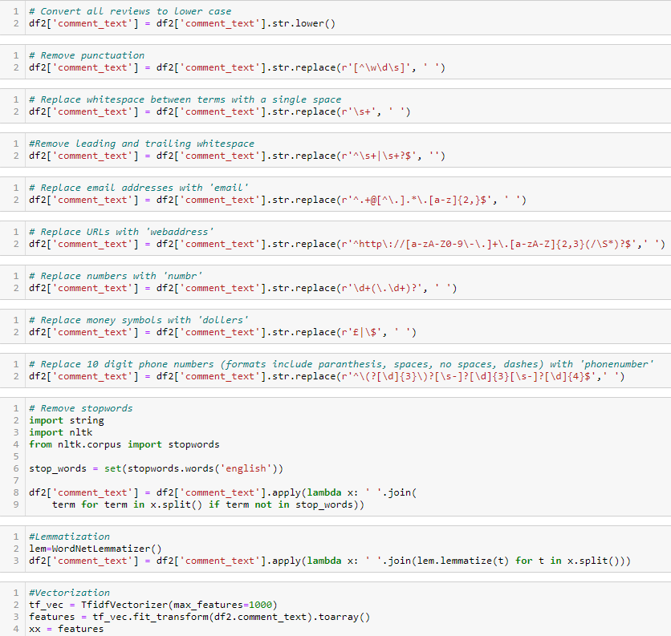
10) Running the test data

Slide 16
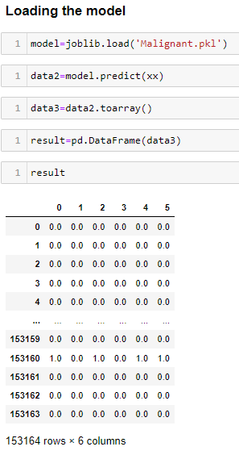
Thus, we have followed all the pre-processing which we have perform on train data.

Slide 17
THANK YOU!!!

